Slide 1
Advances in eVTOL design

Slide 2
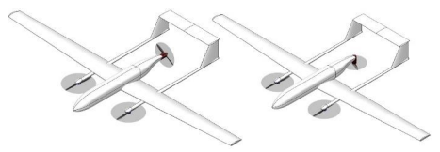
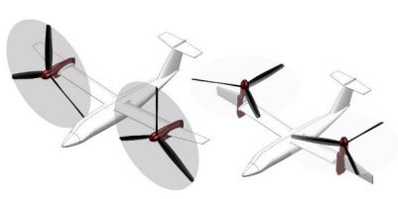
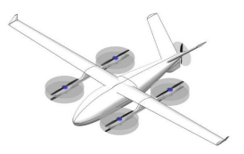
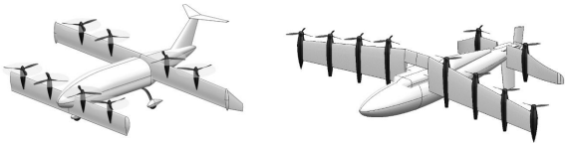
Configurations
Vectored thrust
Fixed motors
Ducted fans
Vectored rotors

Slide 3
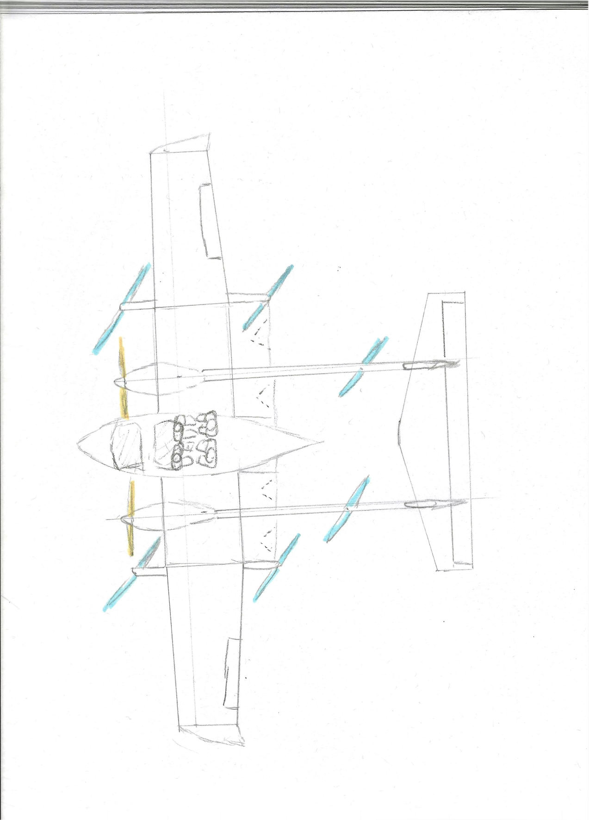
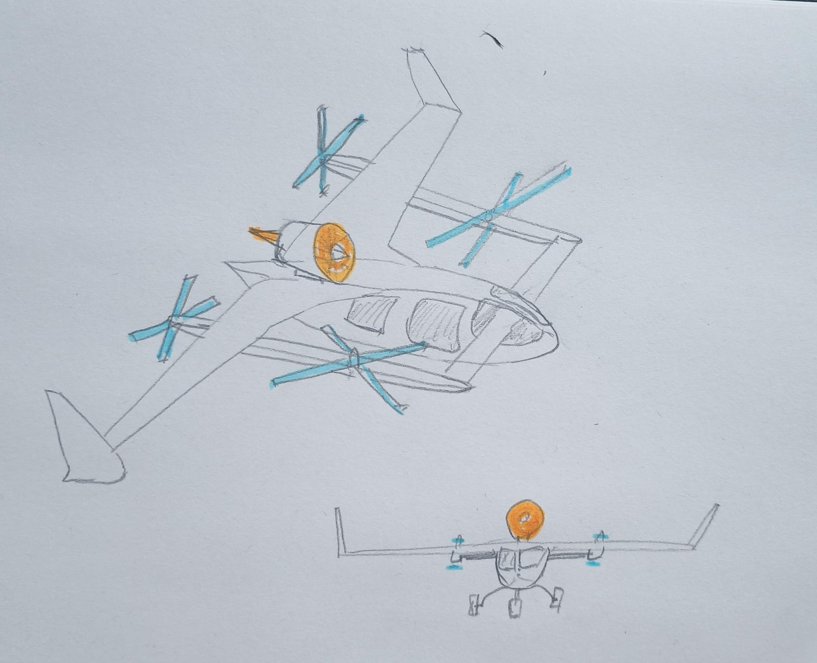
L+C
Advantages:
Efficient motor sizing
Capable of traditional flight (recoverable)
Hybrid feasible
Disadvantages:
Drag and weight penalty

Slide 4
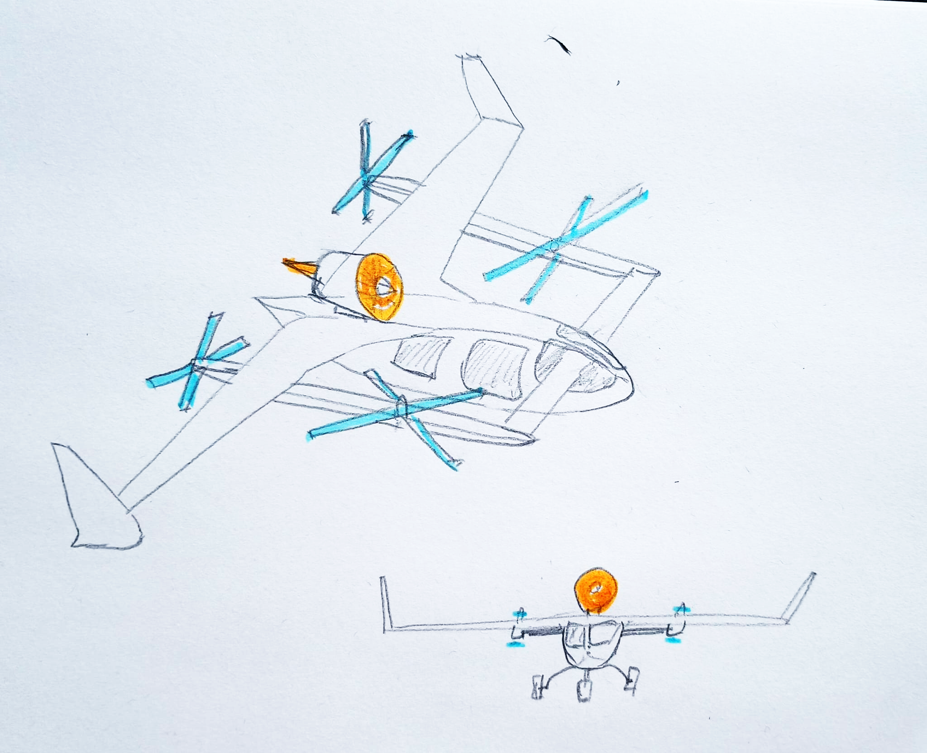
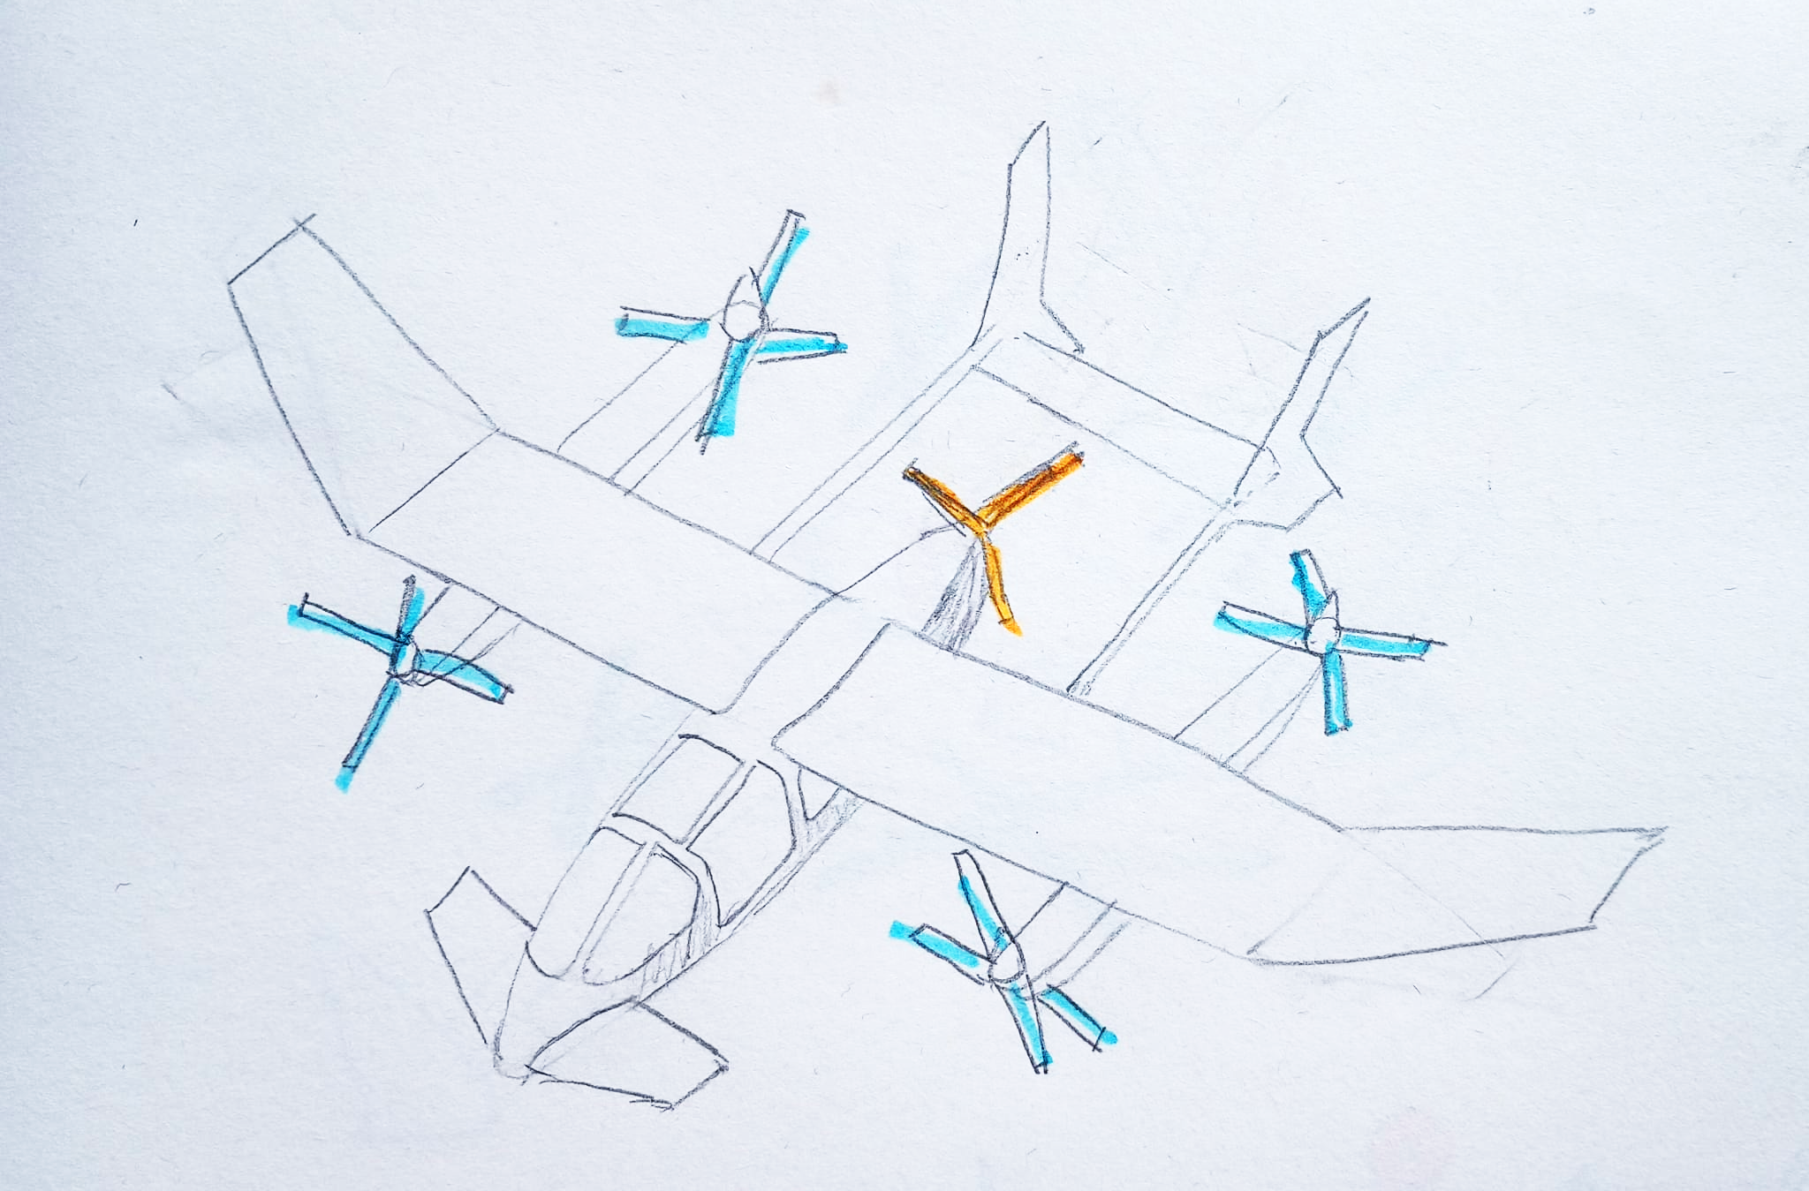
L+C pusher
Open propeller or gas turbine

Slide 5
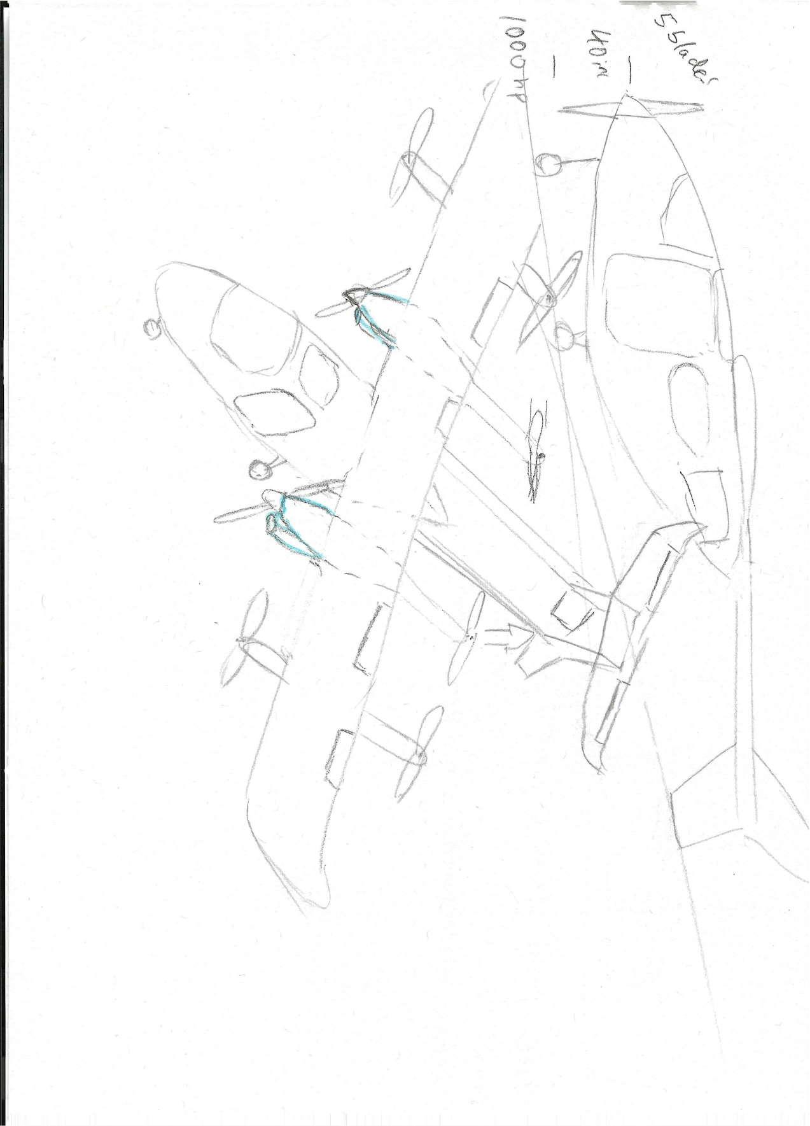

Slide 6
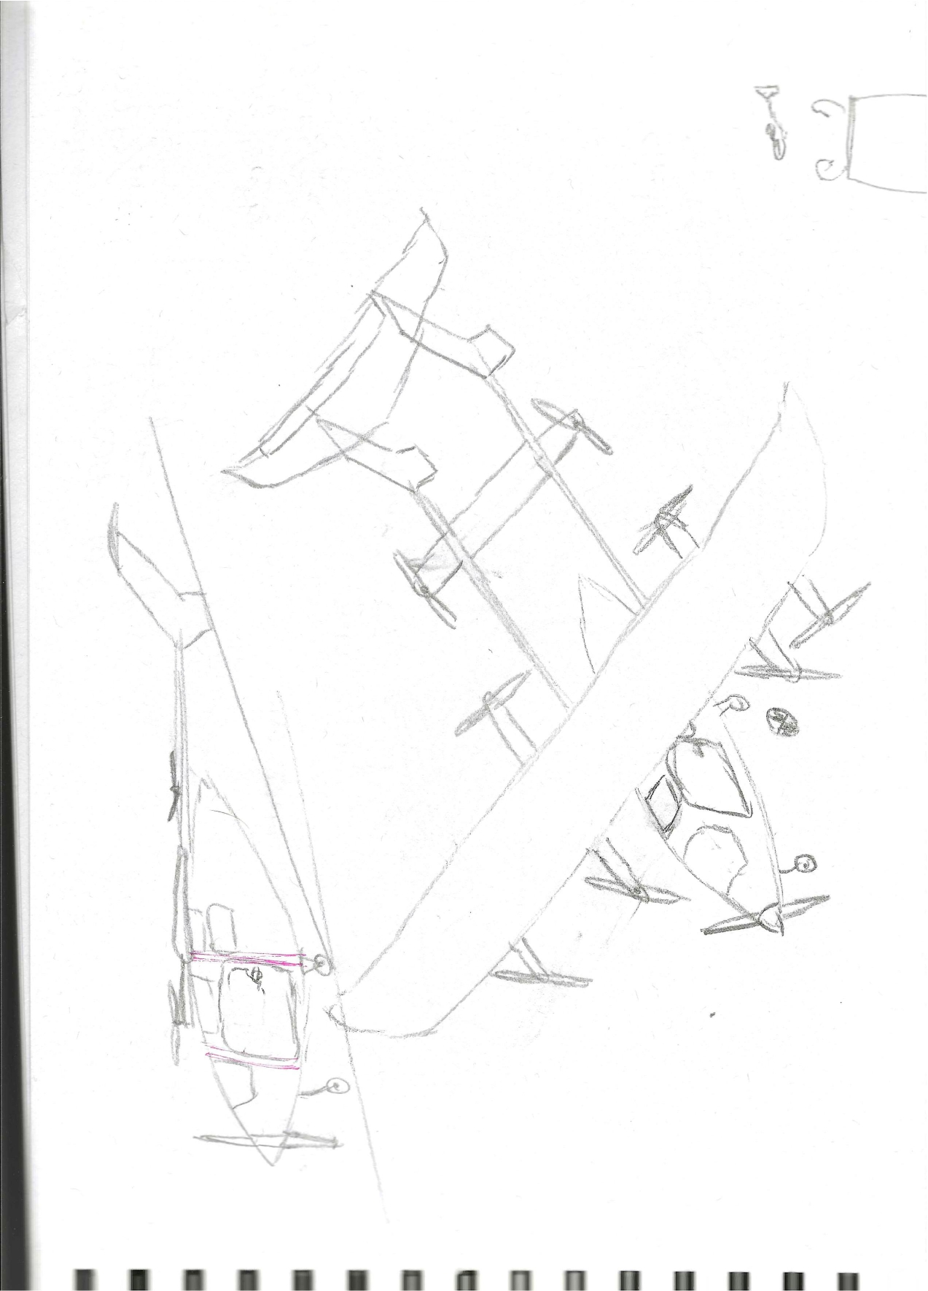

Slide 7
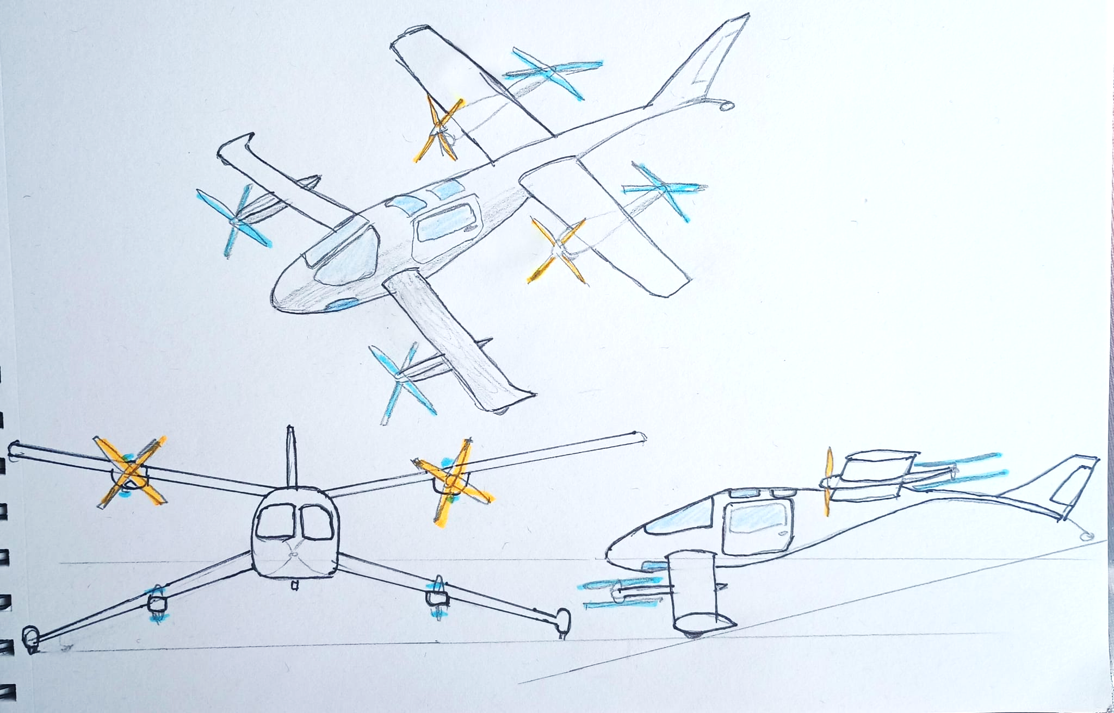

Slide 8
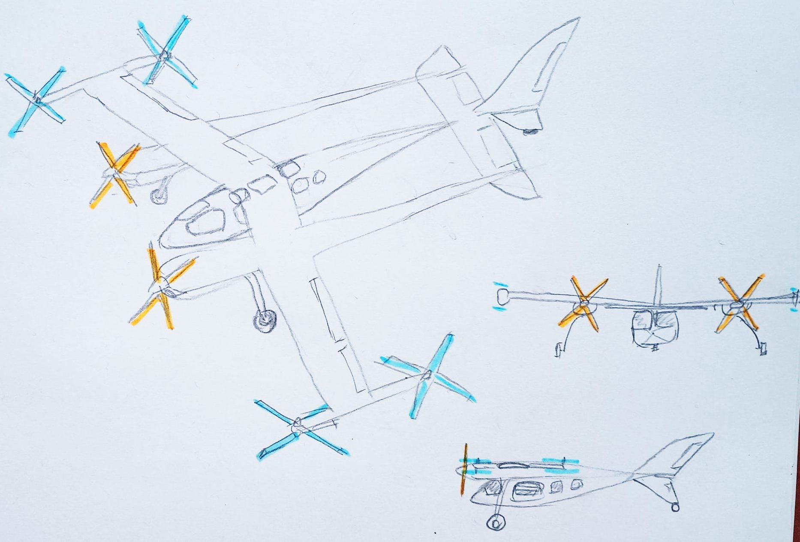
Three body fuselage

Slide 9
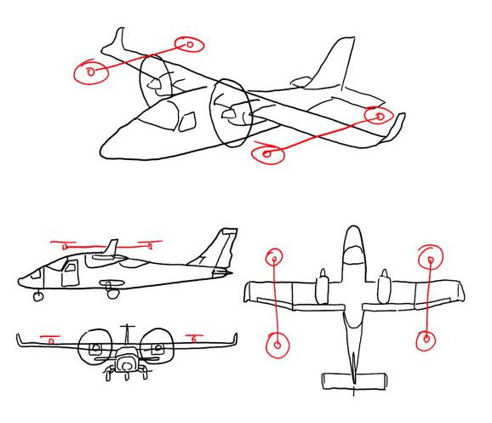
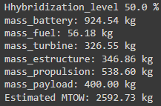

L+C Fixed Open Rotors
L+C Fixed Open Rotors
2 cruise motors + 4 VTOL motors
Cruise: 180 km/h
100% Electric: 3160 kg
50% Hybrid: 2320 kg
Advantages:
Efficient for cruise
Big payload volume
Traditional control surfaces
Disadvantages:
Drag caused by VTOL motors
Weight penalty by VTOL motors

Slide 10
Batteries size / capacity

Slide 11
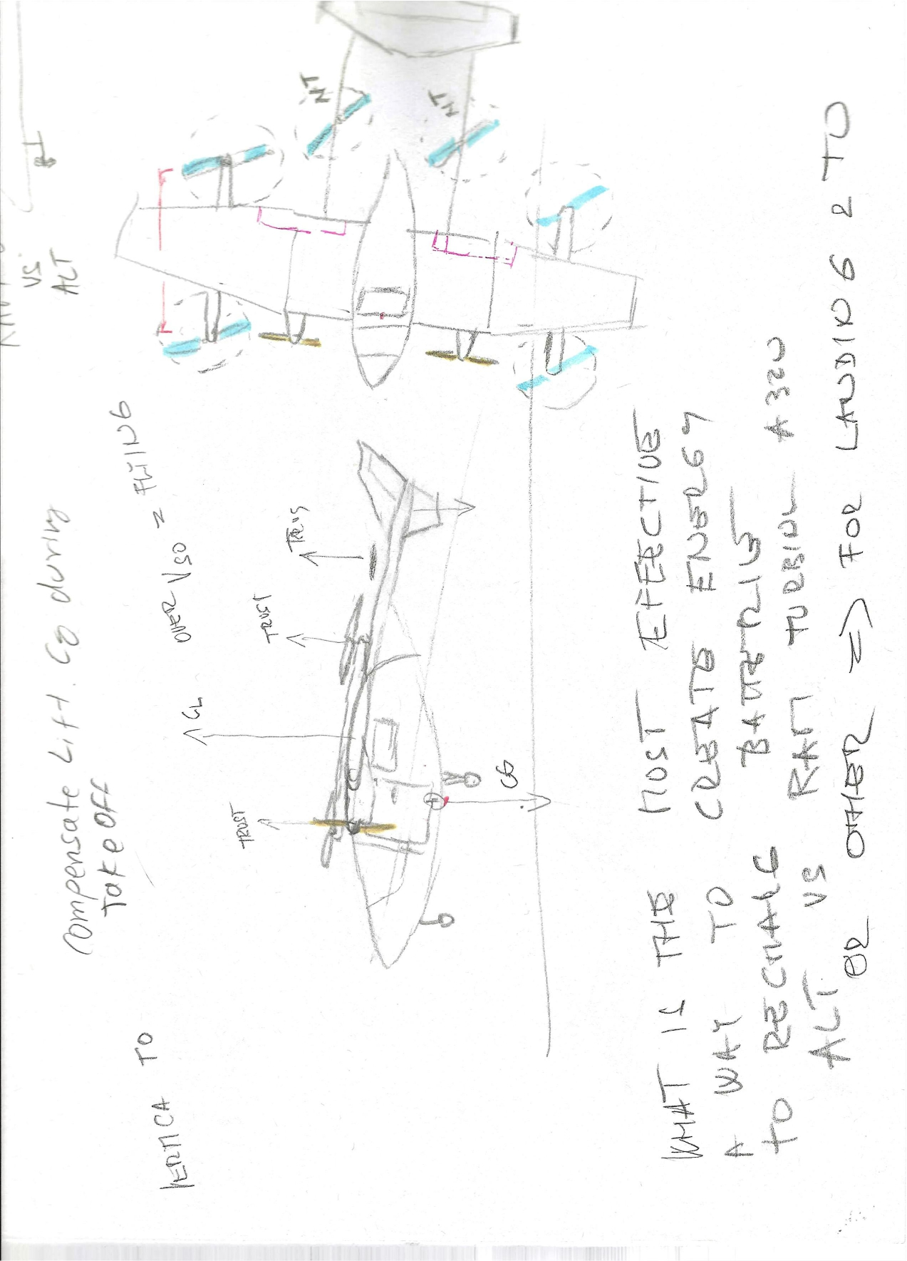

Slide 12
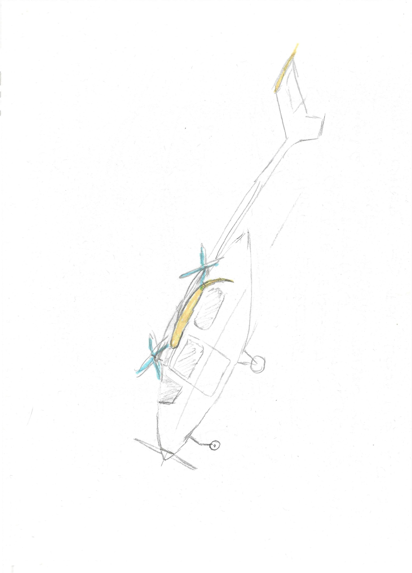

Slide 13
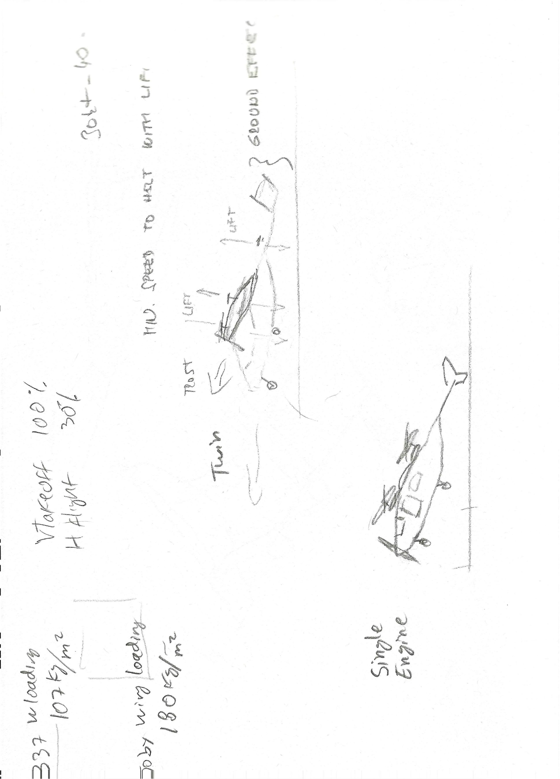

Slide 14
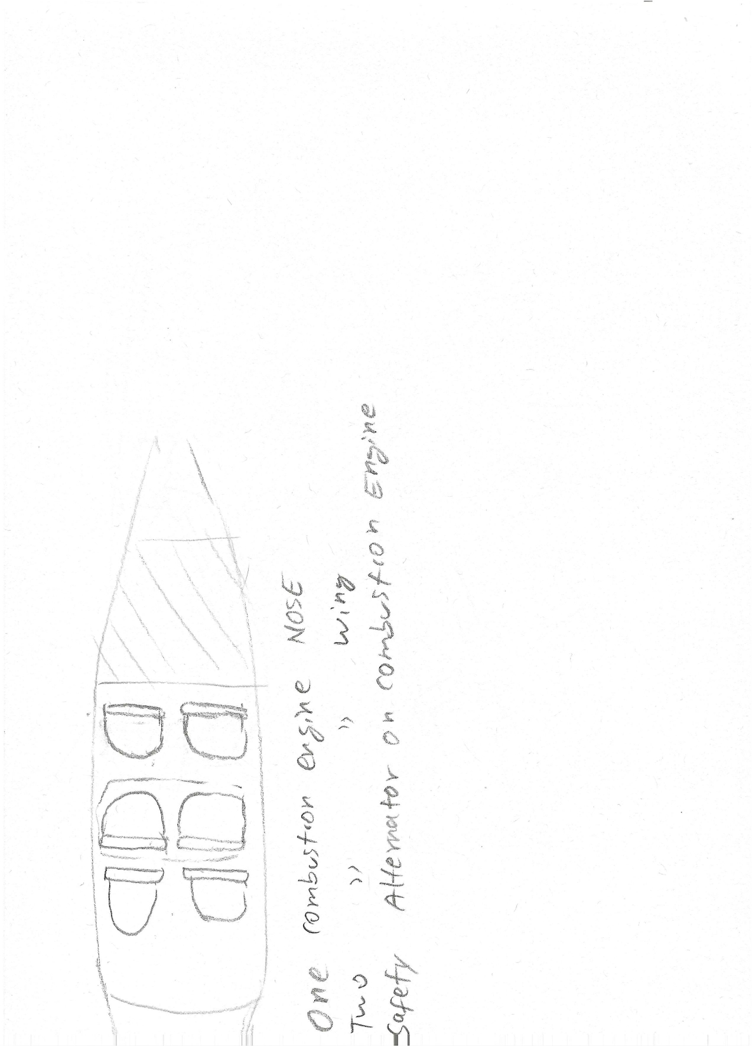

Slide 15
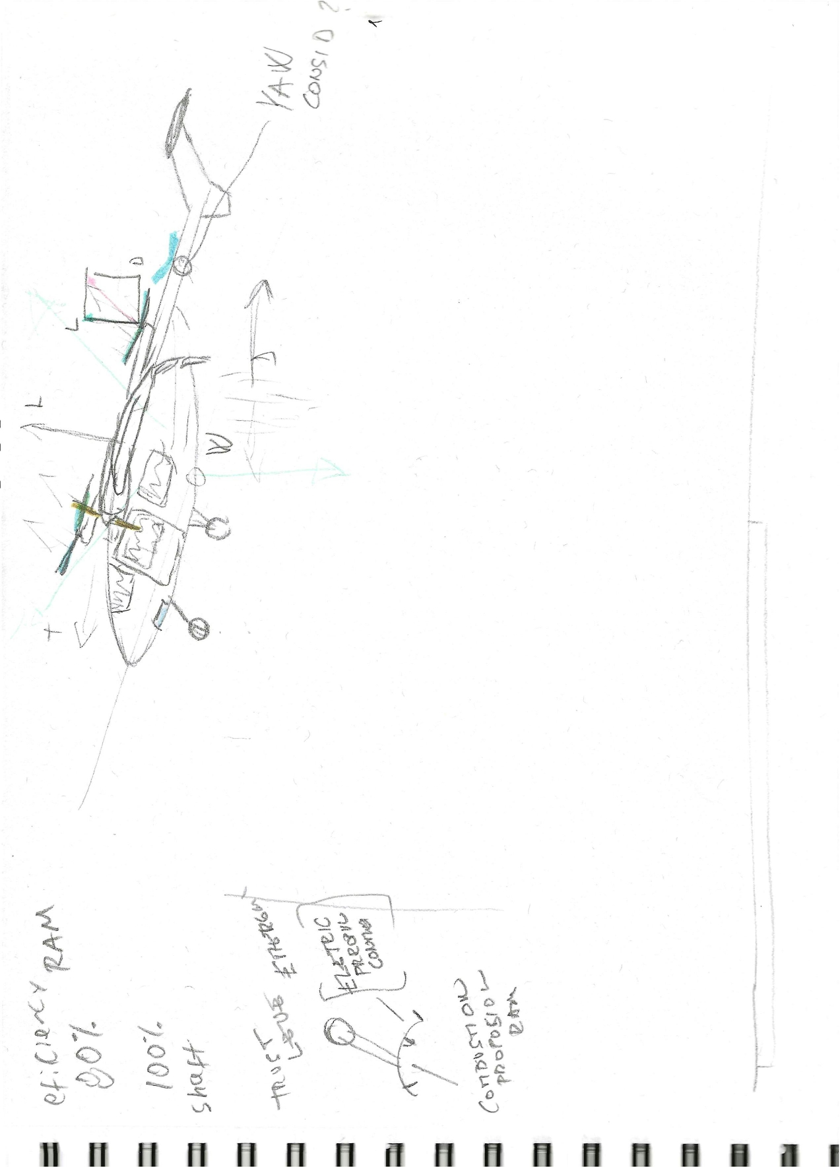

Slide 16
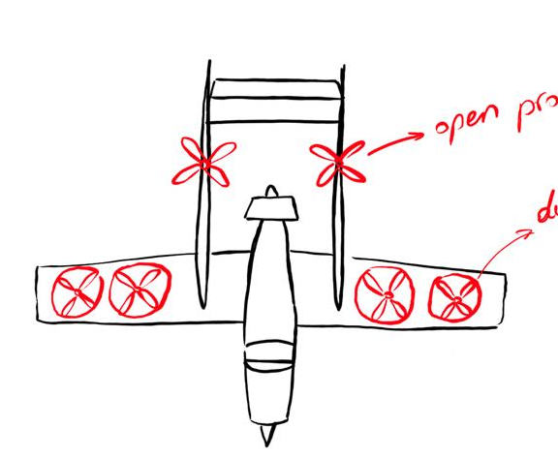
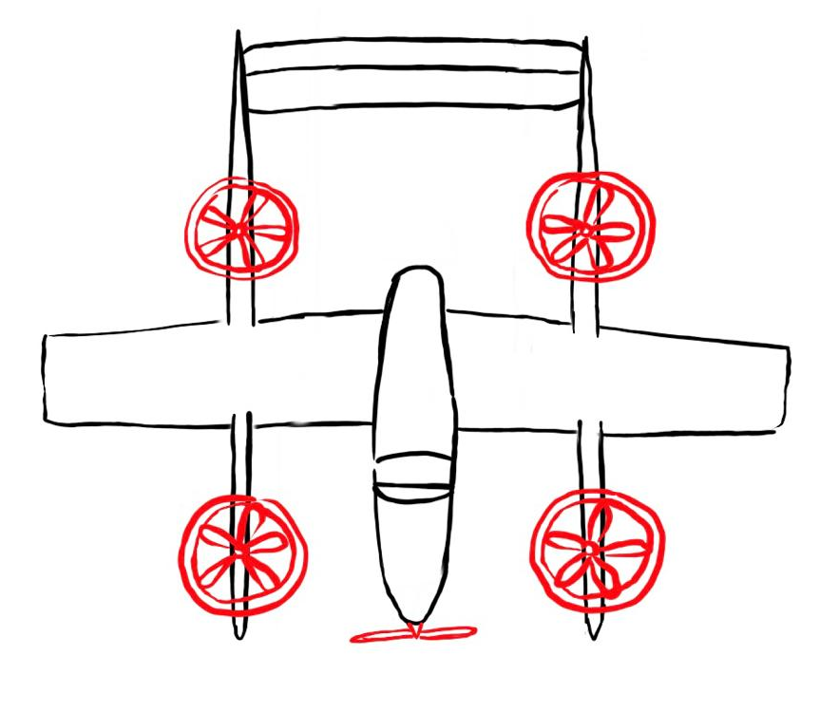
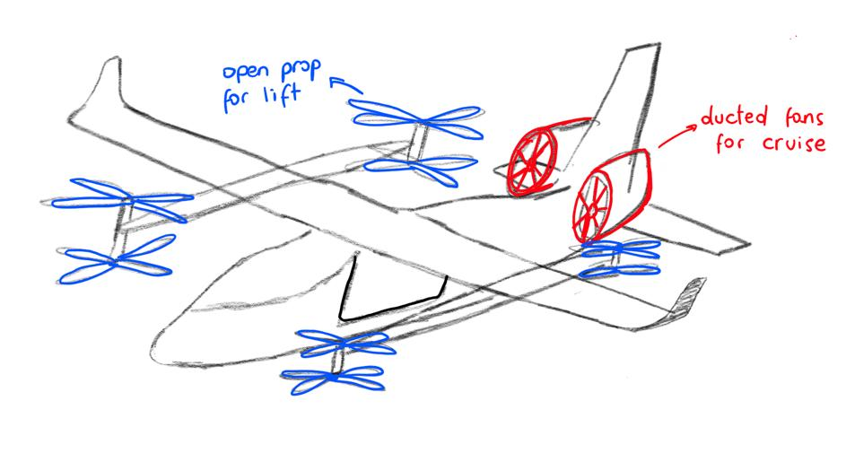
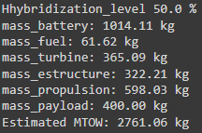

L+C Ducted fans
Advantages:
Quieter, and offer good opportunities for thrust vectoring
Blades more protected from external debris
Efficiency at Higher Speeds
Disadvantages:
Duct structure adds weight
Limited Effectiveness at Low Speeds
Design and Manufacturing Complexity

Slide 17
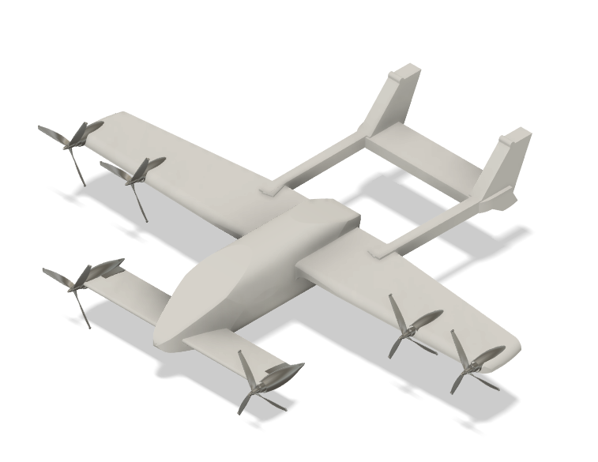
Vectored Thrust
Advantages:
Enhanced maneuverability
Higher efficiency in forward flight
Less weight
Disadvantages:
Vectored thrust adds complexity

Slide 18
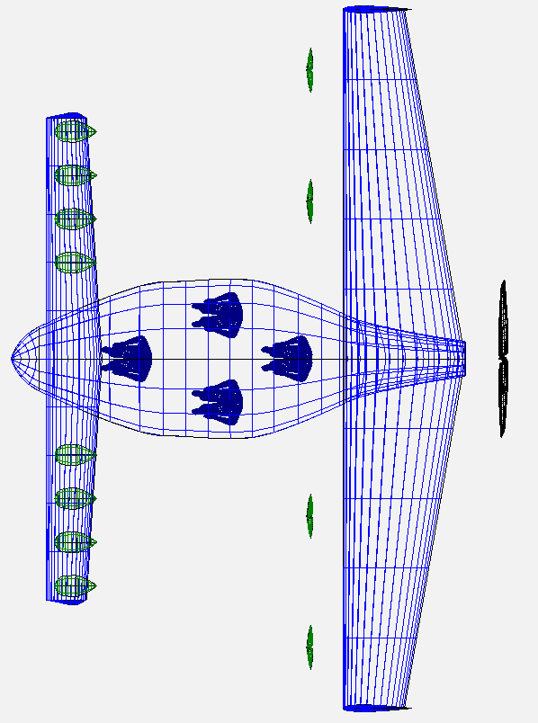
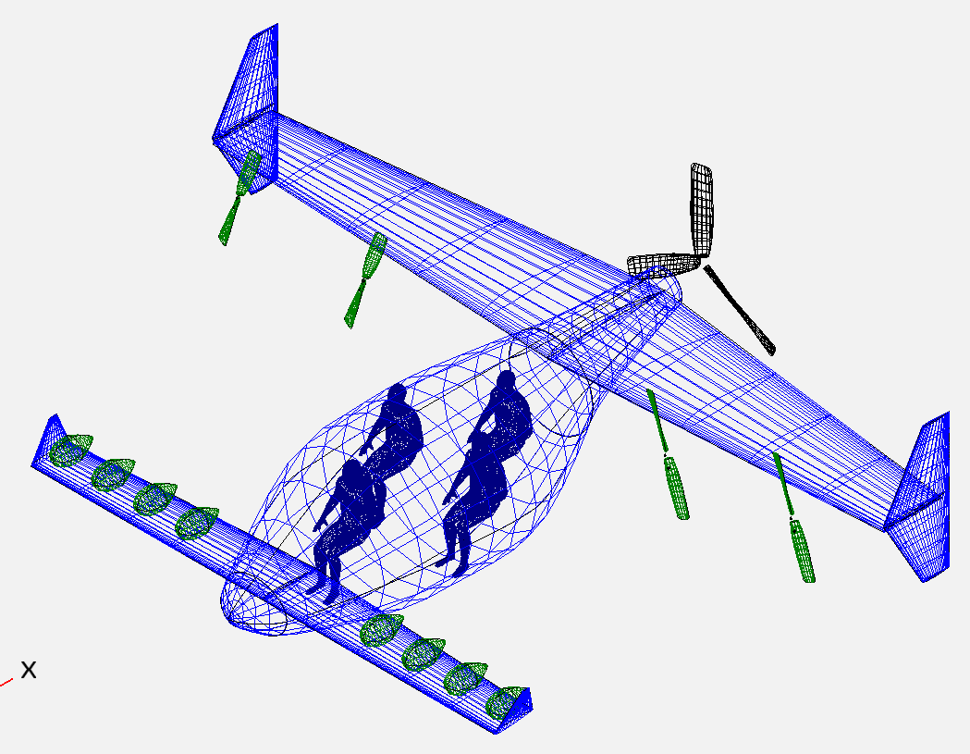
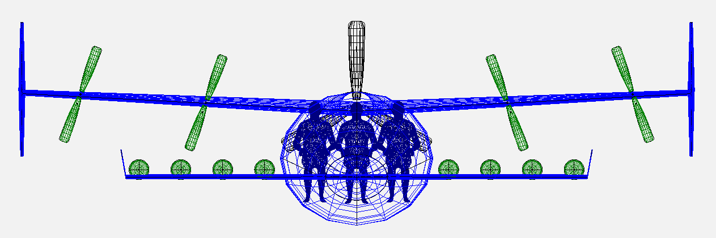
Canard Vectored Thrust and EDF
Advantages:
Easy recovery and control in case of stall.
Tiltable engines for VTOL to cruise transition.
Pusher motor for conventional flight in case of lift motor failure.
Wing loading similar to Cessna Skymaster.
Easy passenger access.
Wider cg range.
Disadvantages:
Complexity in tilt system.
Lower ground clearance, due propeller size.
Acoustic problem in pusher motor.
Characteristics:
Estimated weight: ~ 3300kg
Payload capacity: ~ 400kg
L/D: 13

Slide 19
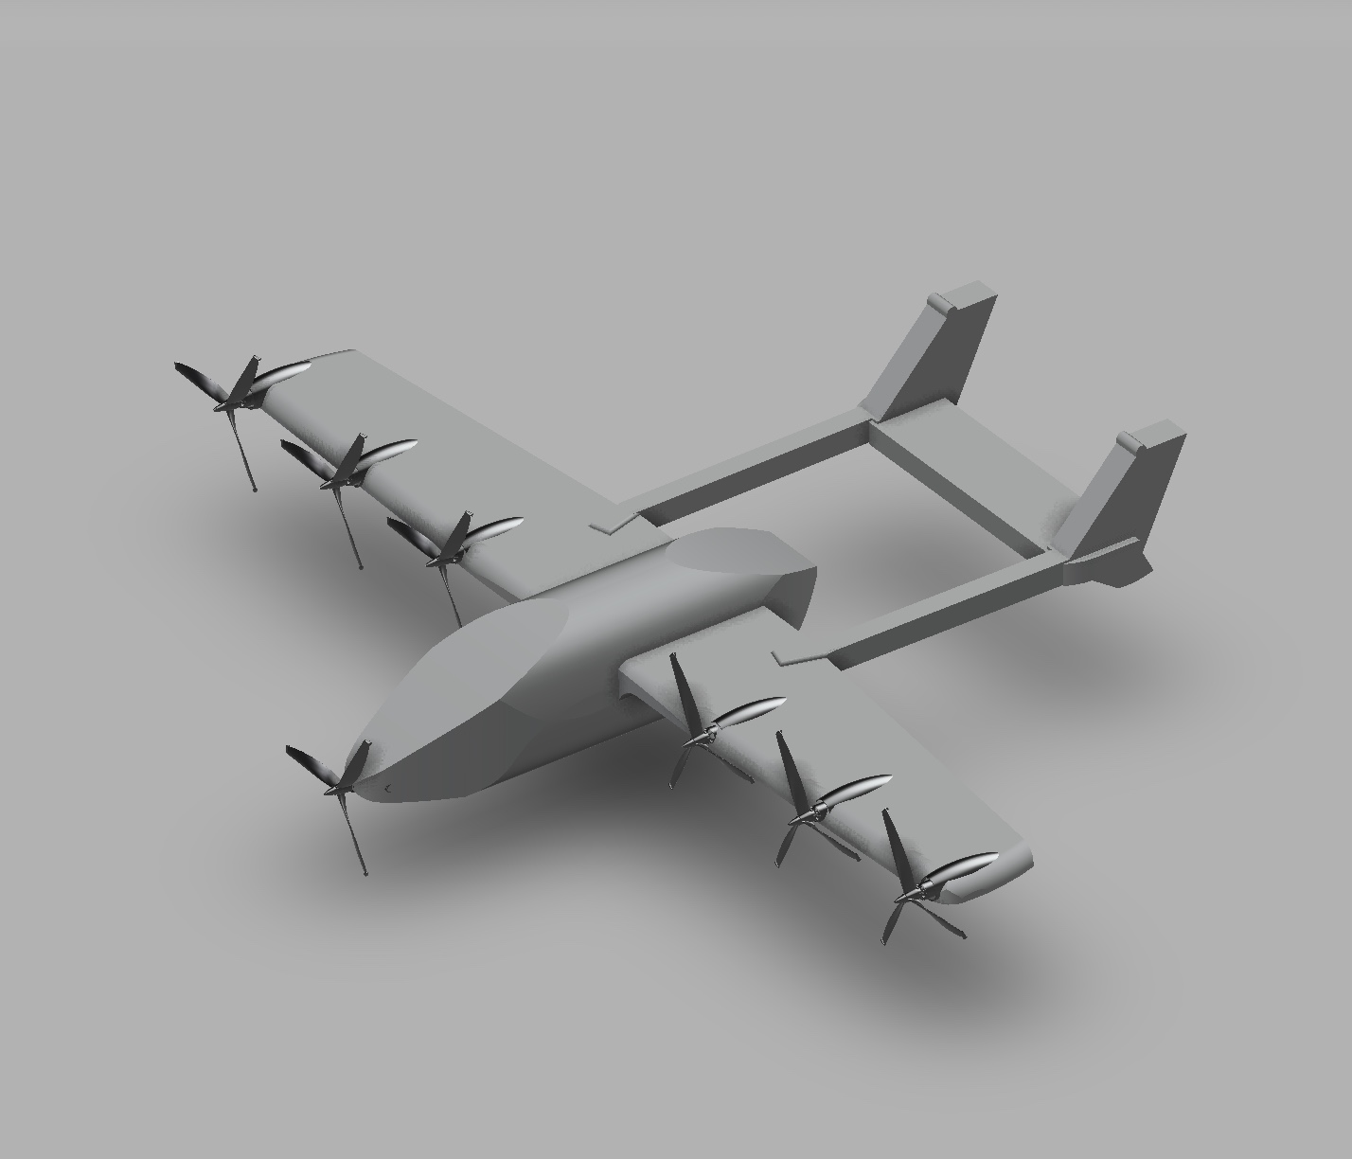
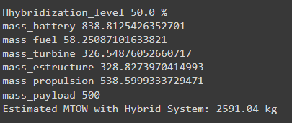
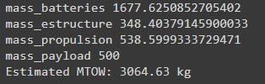
Vectored Open Propeller
Advantages:
Lightweight, simple and less expensive propellers
Easy recovery and control in case of stall.
Tiltable engines for VTOL to cruise transition.
Wing loading similar to Cessna Skymaster.
Disadvantages:
Noisy due to open propellers
Complexity in tilt system.
Lower ground clearance, due propeller size.
Characteristics:
Estimated propellers needed: 6
Wingspan: 11.6 m
50% Hybrid
All electric

Slide 20
Fully electric
vs.
Hybrid
Electricity Cost: $0.13 per kWh Energy Consumption: 200 Wh per km
Maintenance Costs: 1.5% of the initial vehicle cost per year
Initial Vehicle Cost: $1.2 million
Range limited to <150-180 km
SAF Cost: $5 per gallon
Energy Consumption:150 Wh per km from electricity + 0.8 liters per km from fuel
Maintenance Costs: 2.5% of the initial vehicle cost per year
Initial Vehicle Cost: $1.5 million
Range limited to <600 km
$0.18 per passenger mile
$0.69 per passenger mile

